Slide 1



Zoom instructions for this meeting
Please remain muted
throughout the meeting, unless you’re invited to speak by the Chair
Questions
For questions, please use the “hand-raising” function - the Chair will invite you to ask your question
Camera off
Cameras will be used by the Chairs and presenters only
Chat
Please use the chat only for comments and housekeeping questions
Q & A: Shared HackMD document
Please note this session will be recorded

Slide 2
Using the Norwegian e-infrastructure for Life Science and usegalaxy.no

Slide 3
Practical information
All presentation will be given in this Zoom - the main room
The practical exercises will be done in breakout rooms. You will automatically be assigned to a room together with maximum five participants and one teacher
In the interest of time: When you are done with an exercise, please type “Done” in the chat so you can be returned to the main room
All lectures will be recorded. Recording will stop before we open up for questions. Turn off your cameras if you don’t want your face to be recorded
Course material and recorded videos will be publicly available after the course both in the EeLP and in Zenodo
Please make yourself familiar with the ELIXIR code of conduct. Any issues can be reported to david.dolan@uib.no
Please help us improve by completing the feedback survey

Slide 4
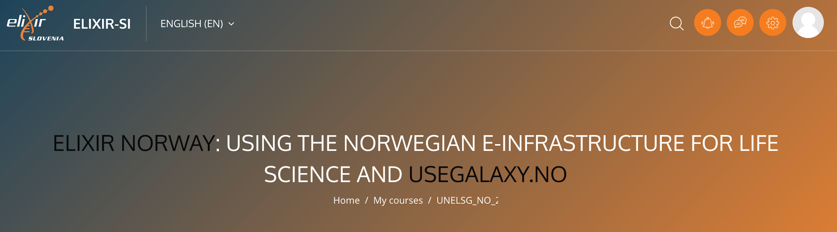
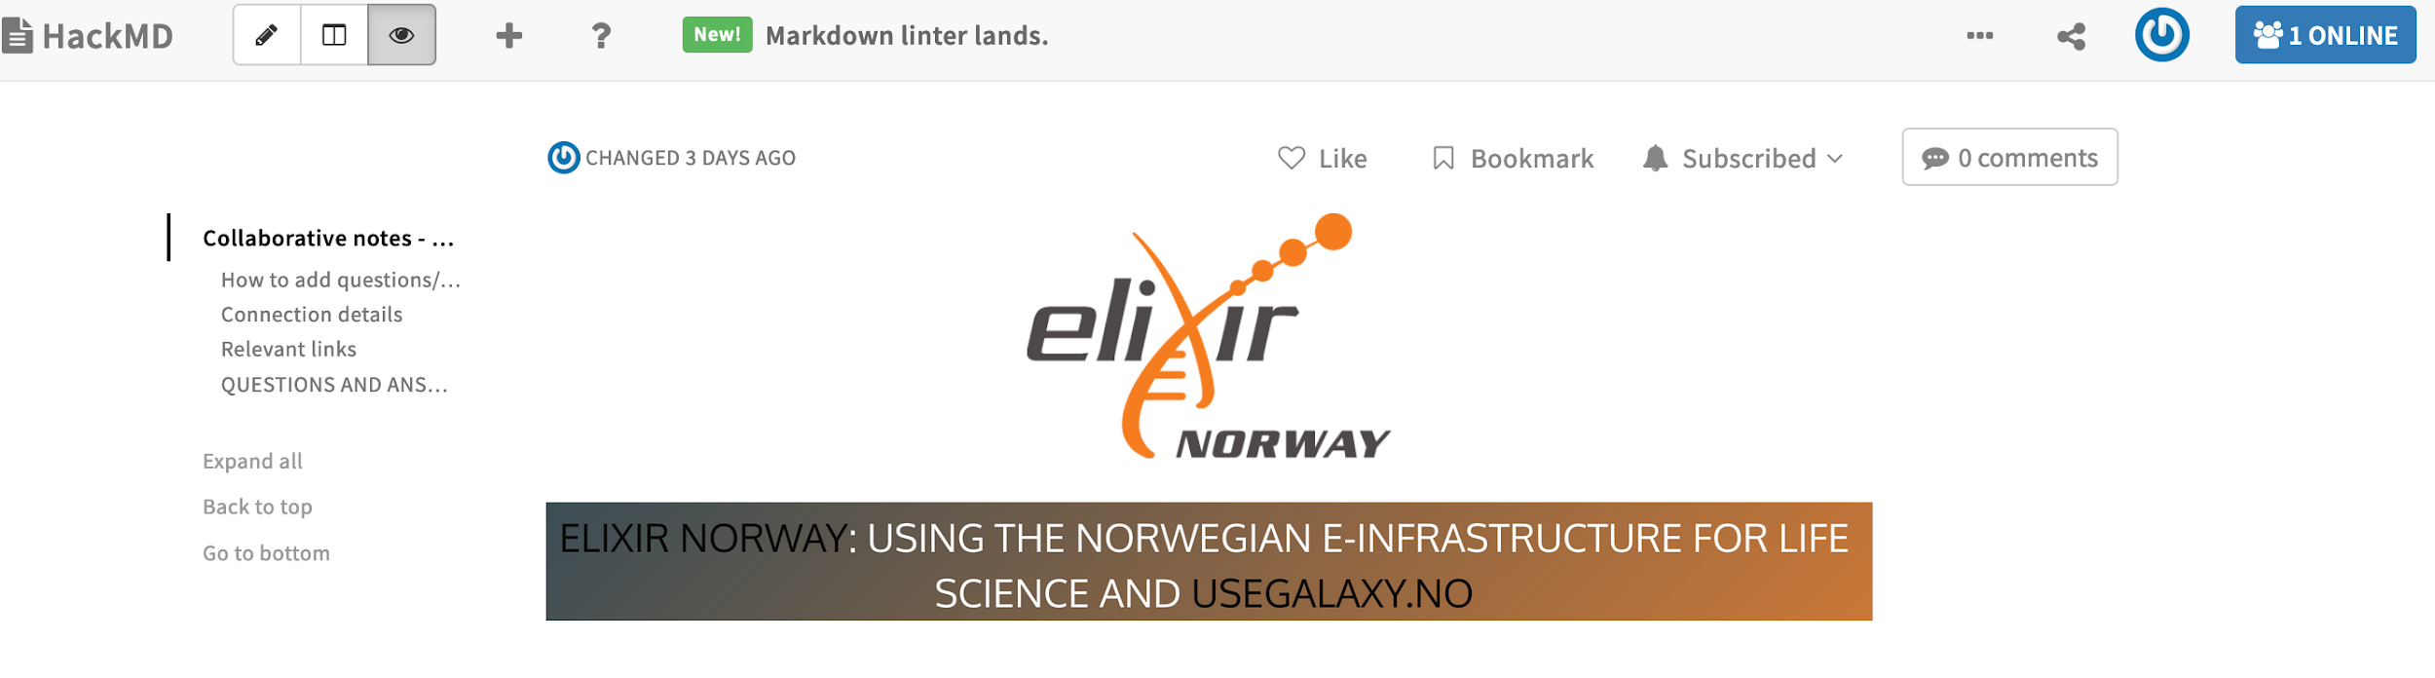
Practical information
Course page: https://elixir.mf.uni-lj.si/course/view.php?id=87
Collaborative notes with questions and answers: https://hackmd.io/@erikh/BkIOfjlN_/edit

Slide 5
Date | Time | Topic
28/11/2022 | 12.00 - Lecture | Welcome and practical information. Introduction ELIXIR and NeLS (and DM)
28/11/2022 | 12.30 - Practical | Logging in finding the relevant urls, and finding the course data
28/11/2022 | 13.00 - Lecture | NeLS: Data transfer and organization
28/11/2022 | 13.20 - Practical | Transfer data to and from NeLS using web browser, FileZilla and command line
28/11/2022 | 13.50 - Coffee
28/11/2022 | 14.15 - Lecture | NeLS and Storebionfo - Projects and storage layers
28/11/2022 | 14.35 - Practical | Transfer of data between NeLS and SBI
29/11/2022 | 15.00 - End
29/11/2022 | 12.00 - Lecture | Introduction to usegalaxy.no and connection to NeLS
29/11/2022 | 12.20 - Practical | Logging in and data transfer between Galaxy and NeLS (both ways)
29/11/2022 | 13.00 - Coffee
29/11/2022 | 13.10 - Lecture | Tools and workflows
29/11/2022 | 13.40 - Practical | Compose and run a simple workflow in usegalaxy.no
29/11/2022 | 14.30 - Lecture | Report issues and how to get help
29/11/2022 | 14.45 - Wrap up | Question and answers

Slide 6
Introduction ELIXIR and NeLS
David Dolan
ELIXIR Norway, Norwegian e-infrastructure for Life Sciences and usegalaxy.no

Slide 7
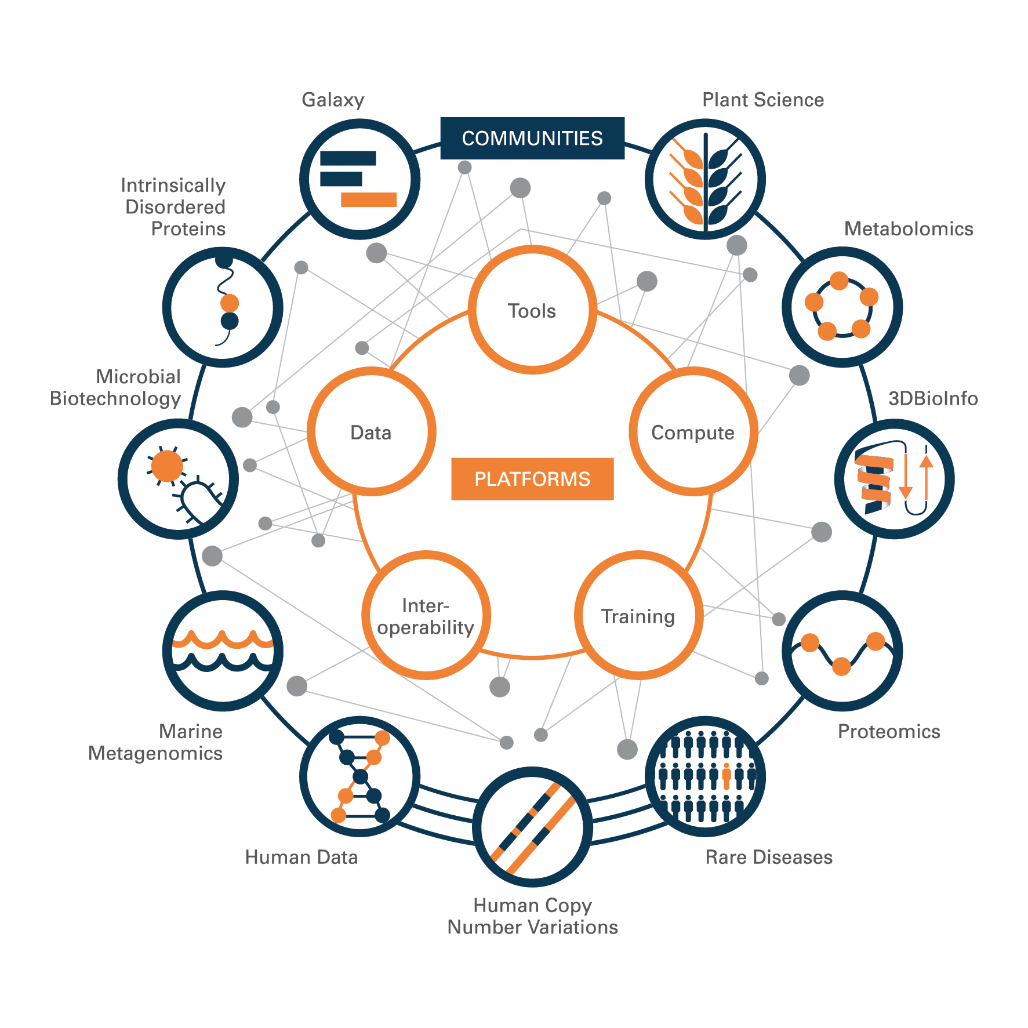
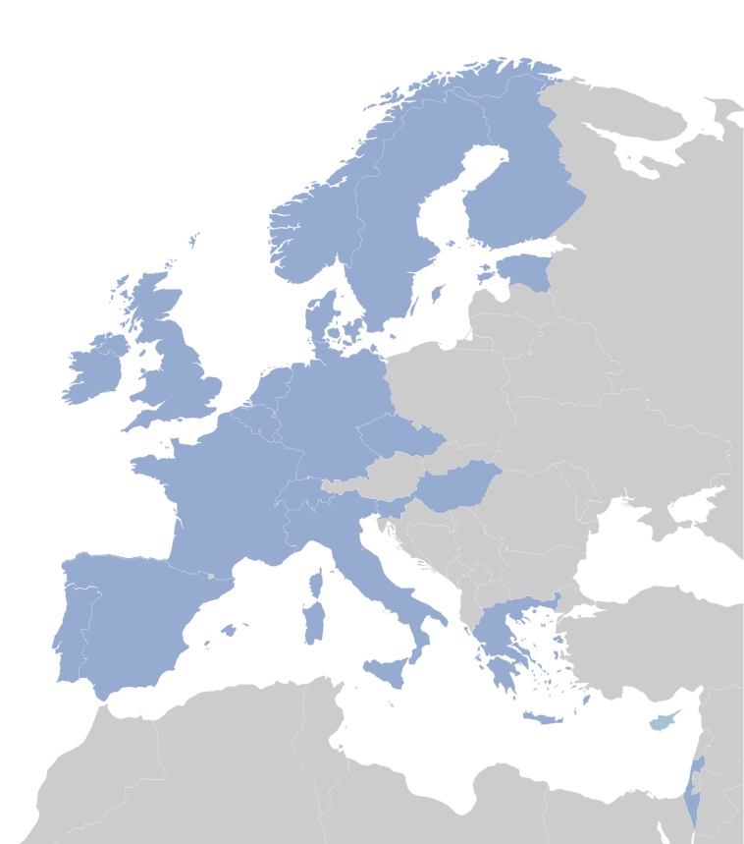
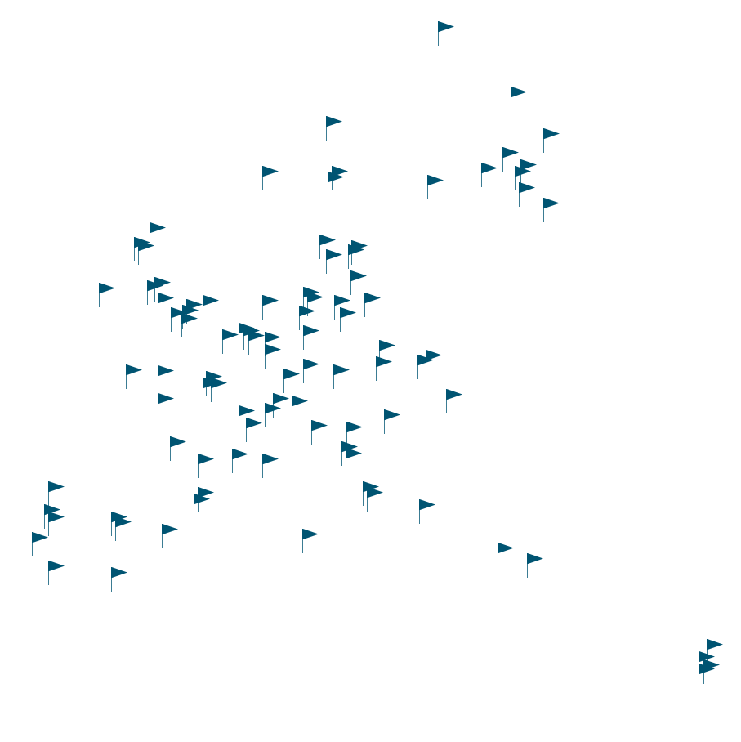
ELIXIR - A distributed infrastructure for Life Science data
Coordinated work across multiple locations
Work together to create common standards

Slide 8





ELIXIR - A distributed infrastructure for Life Science data
Coordinated work across multiple locations
Work together to create common standards

Slide 9
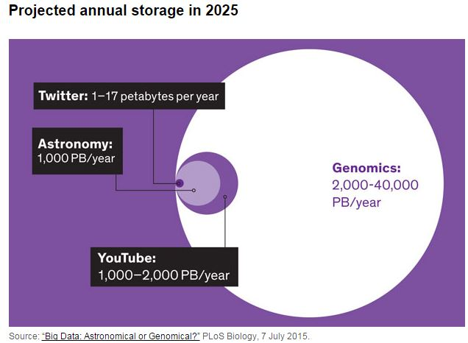
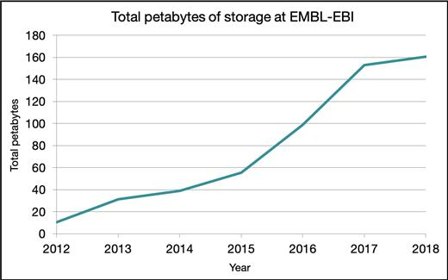
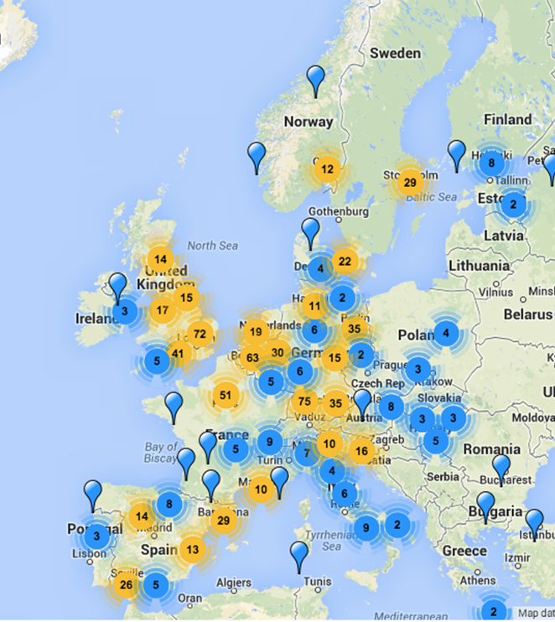
Why do we need ELIXIR?
Example: challenge with data storage and FAIRness of data
64 million requests for data per day
Notes:
Essential to standardise how we store data and metadata
Every second the total information produced in the world is one PB per second. 1 PB is equivalent to over 4,000 digital photos per day your entire life
Development in sequencing technologies is much faster than in computer hardware technologies – We will run out of storage
The total storage capacity at EMBL-EBI is 200 PB = 1 billion CD-ROM discs. This leads to lack of space capacity within 3 minutes

Slide 10
NeLS - Norwegian e-infrastructure for Life Sciences
E-infrastructure provided to all Norwegian researchers within Life Sciences
From academia
From research institutes
From health regions
From private sector
For non-sensitive data. (Elixir Norway also support projects in TSD for sensitive data.)
Compute resources and tools for data analysis
Multiple storage layers
Data Management
Developed and operated by Elixir Norway, running on top of Elixir Norway servers as well as the generic storage services NIRD operated by Sigma2.
User support provided by the Elixir Norway helpdesk

Slide 11
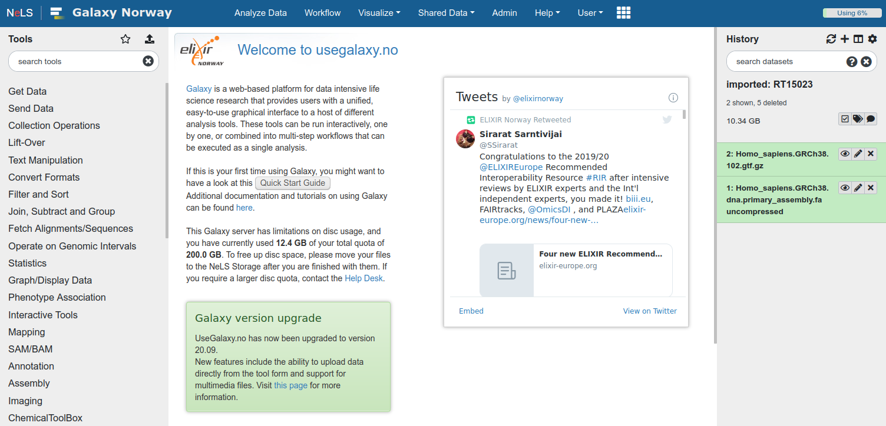
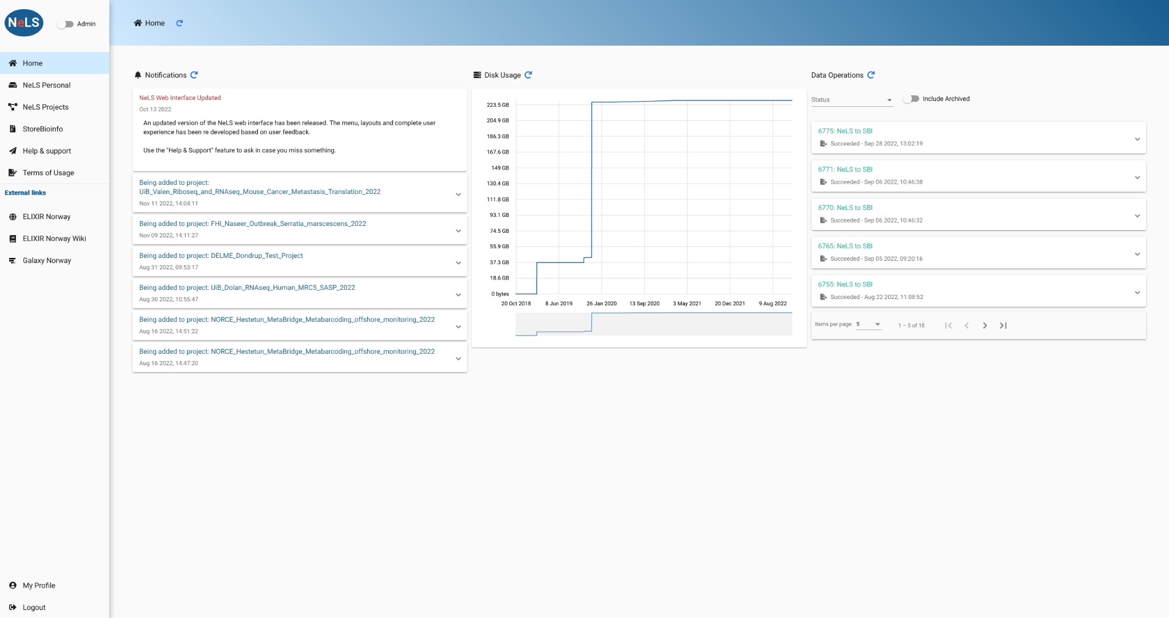
NeLS - Norwegian e-infrastructure for Life Sciences
+ https://usegalaxy.no
= https://nels.bioinfo.no

Slide 12
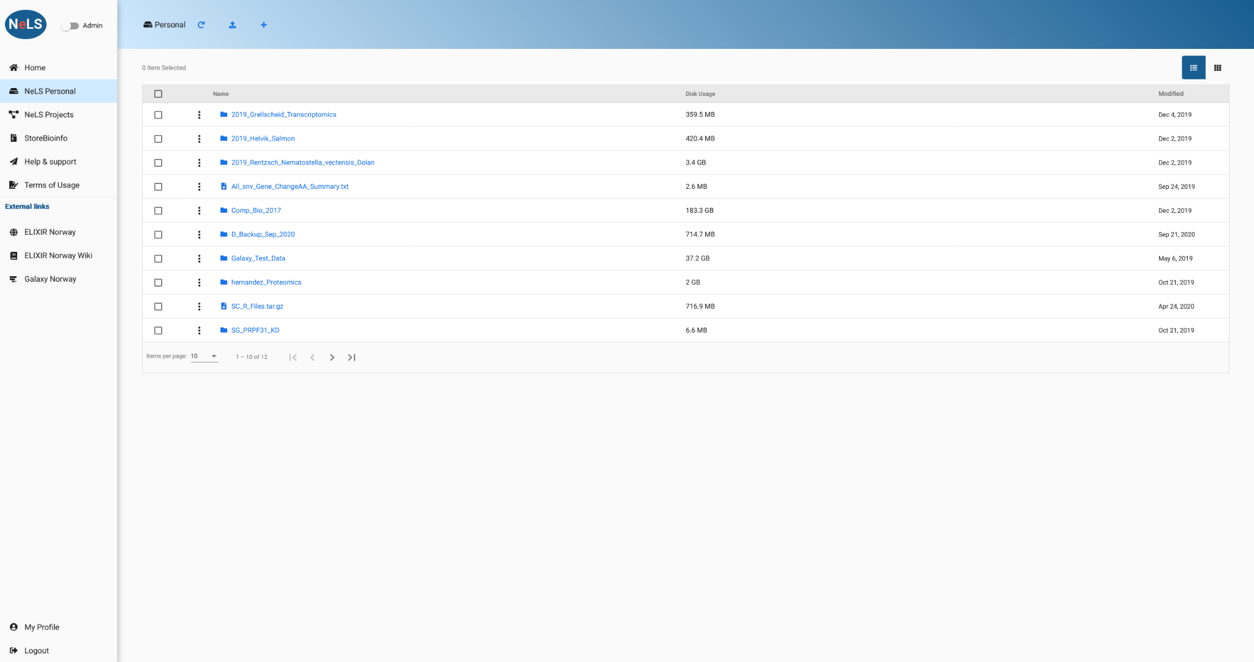
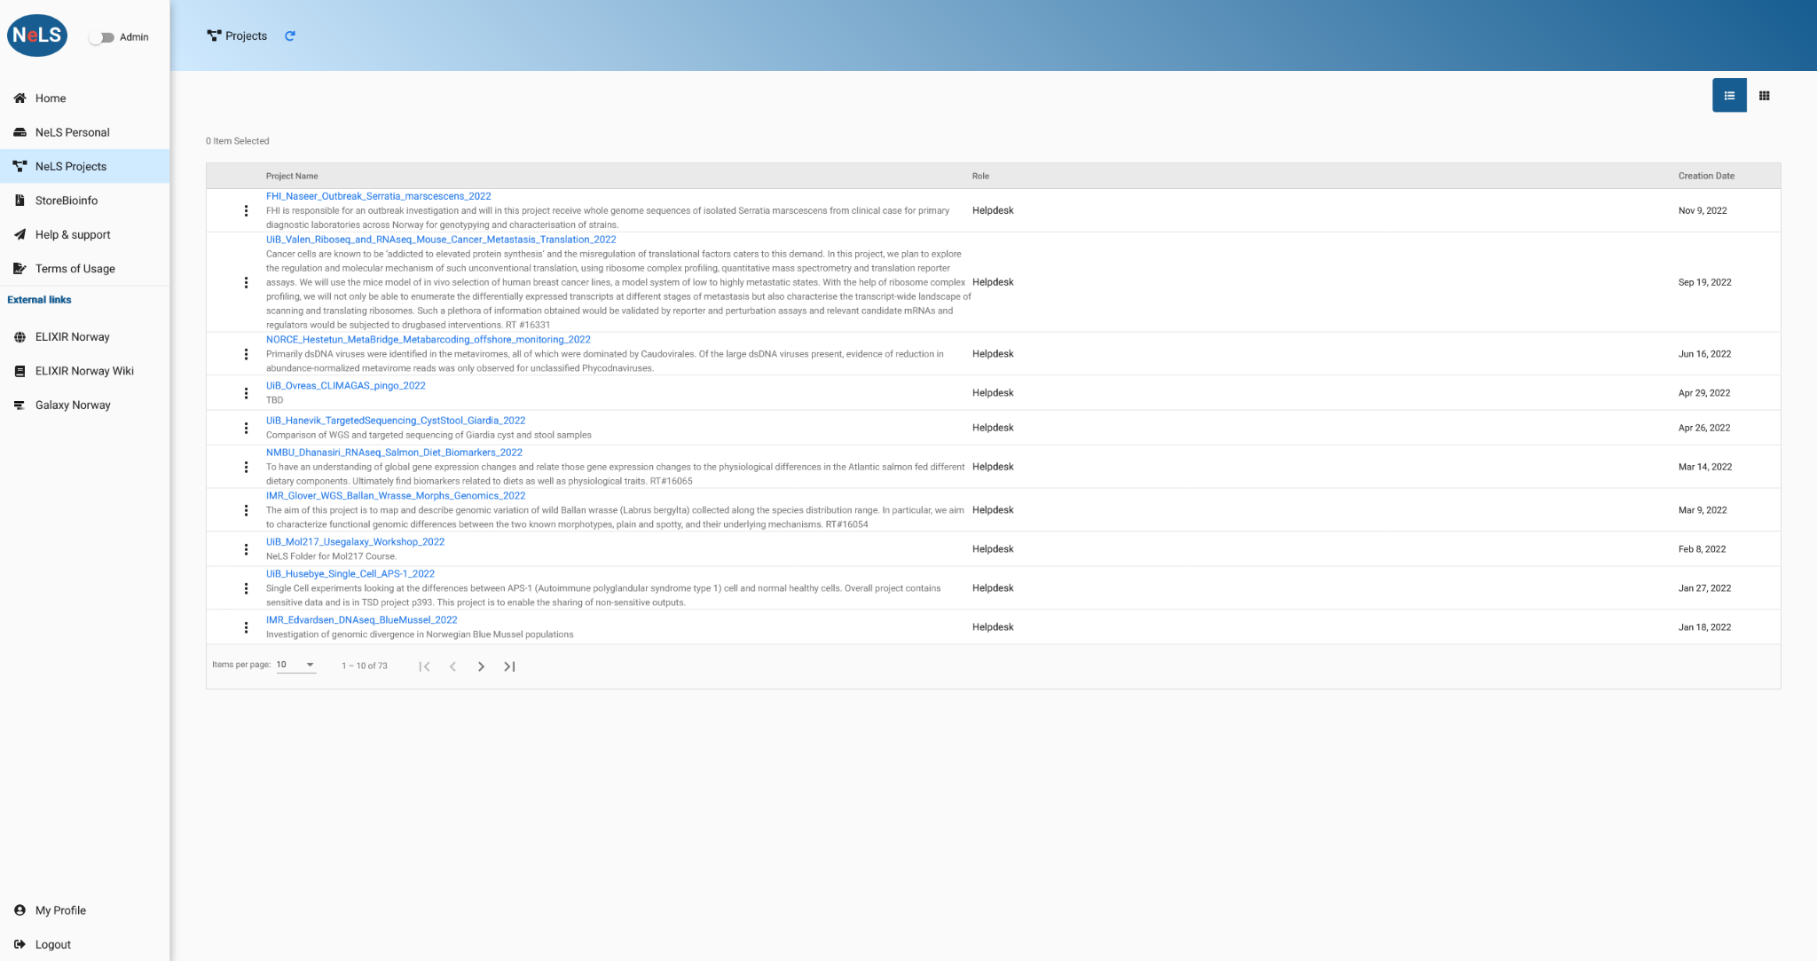
Access to storage and sharing of data in NeLS
Access to personal storage and projects
Notes:
Access to personal storage and projects and SBI
Managing data – different roles

Slide 13

Data management
Data management is a process that includes acquiring, storing, protecting, and processing data
ELIXIR promotes FAIR data
Notes:
FAIR data means data that meet principles of findability, accessibility, interoperability, and reusability

Slide 14
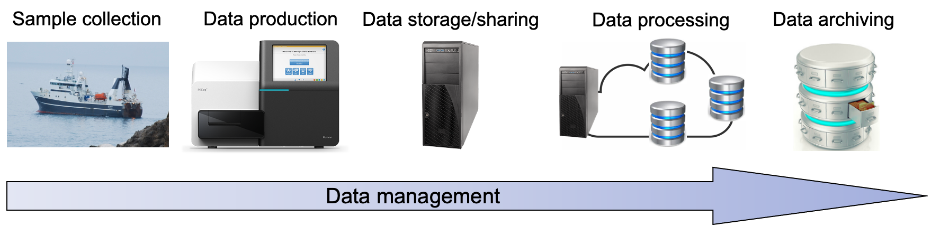
Data management planning
Data management planning is required for all grant applications
Important to capture metadata in all parts of the project

Slide 15
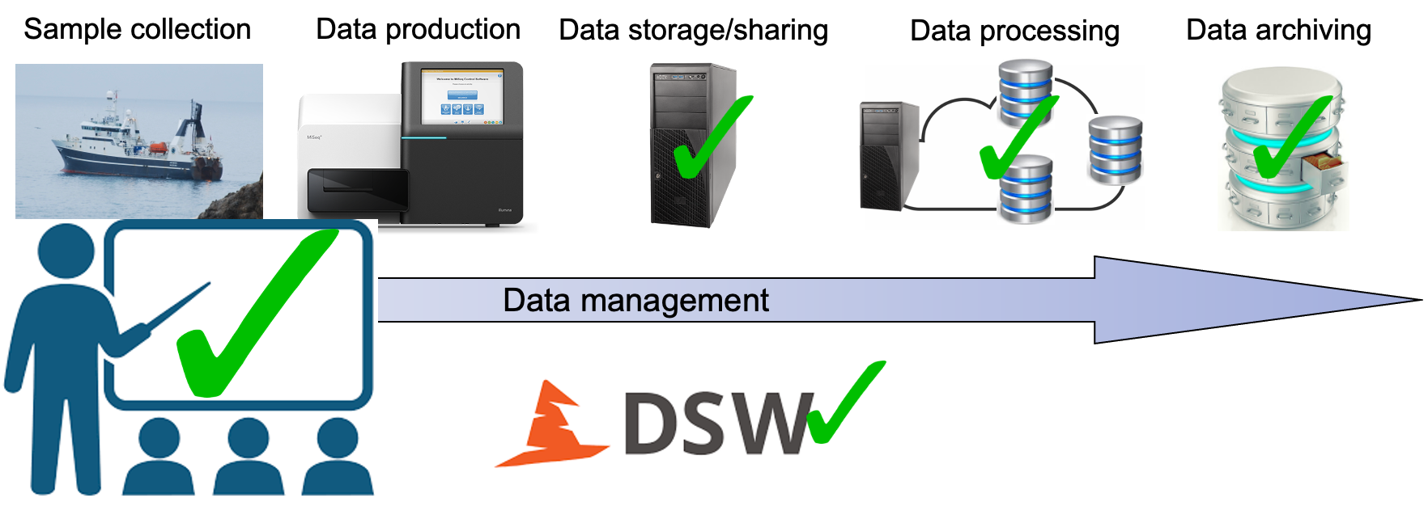
ELIXIR offers support in data management planning
Service and collaboration and support
Access to data, tools, compute & storage
Data management planning portal
Provide connection to other international ELIXIR nodes
Training, courses and Hands-on workshops

